Slide 1

Customer Profiling in Relationship Banking
Internship Project
Tools: SQL & Power BI
By Kokilapriya

Slide 2

Project Overview
This project analyzes customer financial behavior in a relationship banking system.
Raw banking data was cleaned using SQL and visualized using Power BI to generate business insights.

Slide 3
Objectives
Understand customer account distribution
Analyze liabilities and loan structures
Identify customer financial patterns
Support data‑driven banking decisions

Slide 4
Tools & Technologies
• SQL – Data cleaning and transformation
• Power BI – Data visualization
• Banking dataset – Customer financial records

Slide 5
Data Cleaning Process (SQL)
• Standardized data types for financial columns
• Renamed inconsistent column names
• Handled missing and zero values
• Removed duplicate customer records
• Standardized text fields such as names and IDs

Slide 6
Feature Engineering
Created Total Liquid Assets from checking and savings accounts
Created Assets Under Management (AUM)
Calculated Total Liabilities from loan related fields
These features helped analyze overall customer financial strength.

Slide 7
Key Performance Indicators
Total Liability
Total Superannuation
Total Checking Accounts
Total NRI Accounts
Total Savings Accounts

Slide 8
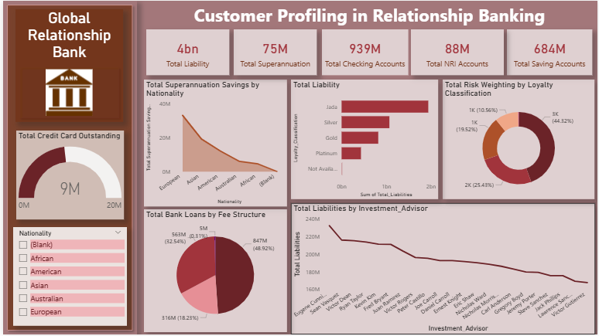
Dashboard

Slide 9
Key Insights
• Checking accounts represent the highest customer activity
• Savings accounts show strong customer trust
• Superannuation savings vary by nationality
• Some investment advisors manage higher liabilities than others
• One loan fee structure dominates the lending portfolio

Slide 10
Conclusion
The project demonstrates a complete data analytics workflow including
data cleaning, transformation, feature engineering, and visualization.
The dashboard helps understand customer financial behavior.

